Slide 1
Vehicle Loan

Slide 2
Introduction
Vehicle Loan
Main agenda of the vehicle loan project is to digitalise the loan taking process which makes users comfortable to take vehicle loans
Users need to register themselves in the website to make use of all the features in the website
Users who registered and not registered can calculate EMI using EMI Calculator and have an estimated idea about the loan which will be useful to make decision about the loan they want to take
Registered users can apply the vehicle loan from remote areas. They will have to enter necessary details like employment details, vehicle details, bank details, identity documents upload etc., and apply for the loan
The website has user dashboard and admin dashboard for the convenient access to all the features

Slide 3
Modules
User Module
Home: Home page includes the basic information about the bank. Registered and non registered users can access home page
User Registration: New users need to register by providing necessary Information
User Login: Registered users need to login to the website to access the main features
Apply Loan: Registered users can apply for the loan online by providing the vehicle details, employment details, bank details and uploading necessary documents. They get to choose the loan offers according the vehicle type they have chose
Loan Profile: Loan profile includes the information about current loan if accepted by the admin and status of the loan whether the loan is accepted, rejected or pending
User settings: User settings includes changing password and edit profile

Slide 4
Modules
Admin Module
Home: Home page includes the basic information about the bank. Admin can view home page even before logging in
Admin Login: Admin can login using his/her credentials and access the admin dashboard to approve the loans
List of Applications: Admin can view all the users loan application details in a list with an option to approve or reject
Approved applications: The list of applications which admin approved will be displayed in the approved application page
Rejected applications: The list of applications which admin rejected will be displayed in the approved application page
Loan offers: Admin can view all the loan offers that are available to the user for all types of vehicles

Slide 5
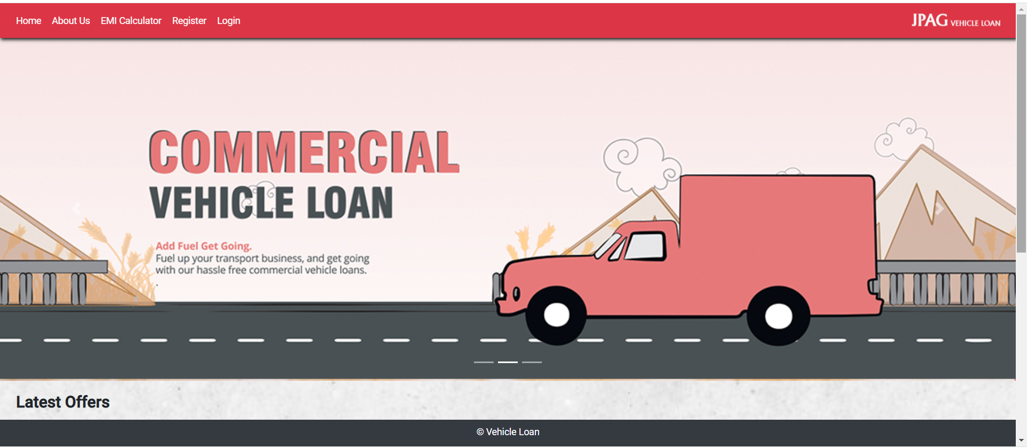
Screenshots
Home

Slide 6
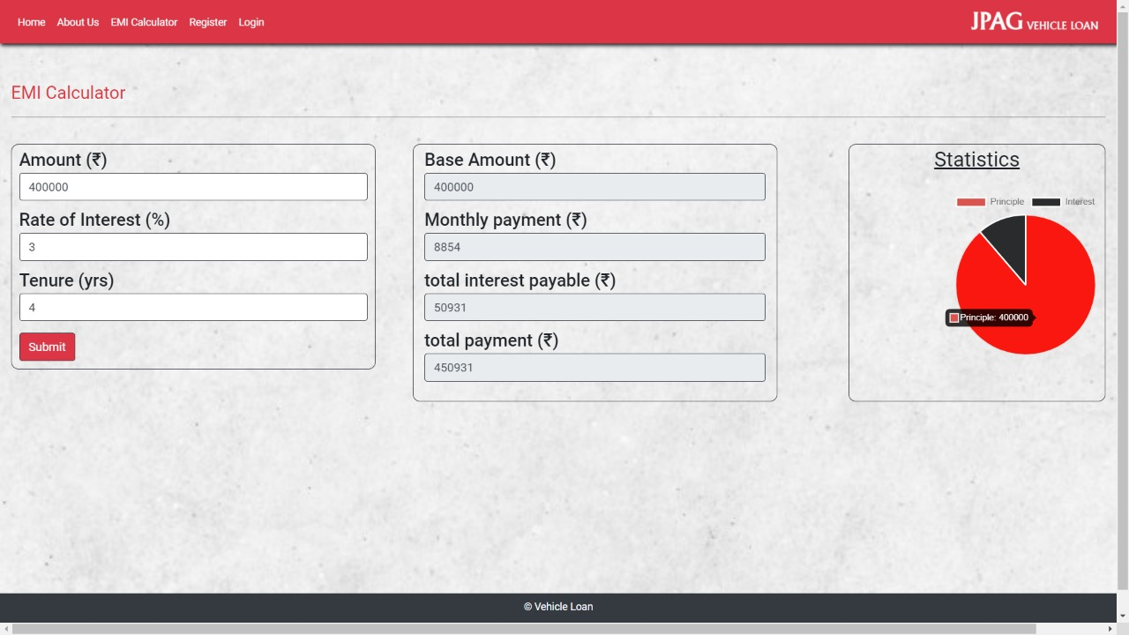
Screenshots
EMI Calculator

Slide 7
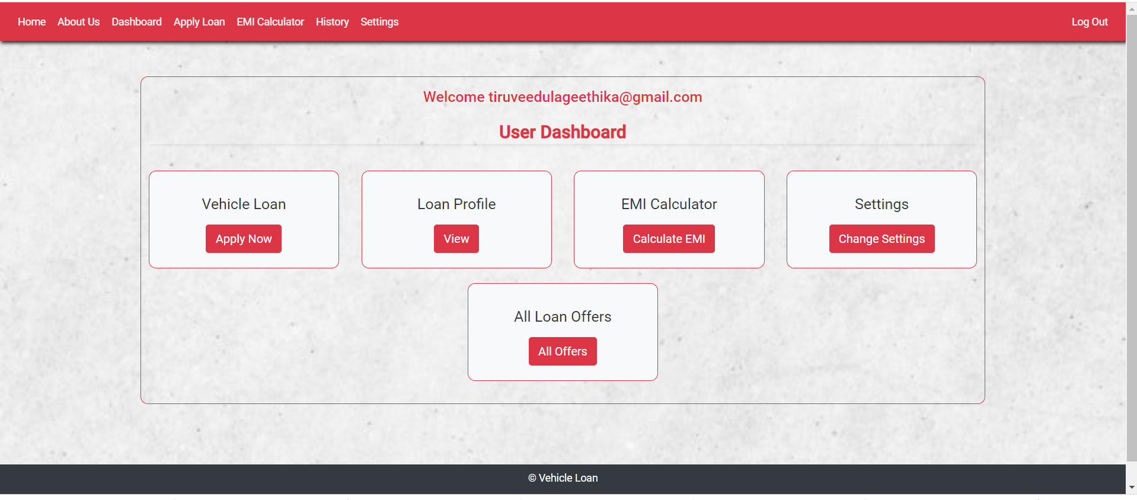
Screenshots
User Dashboard

Slide 8
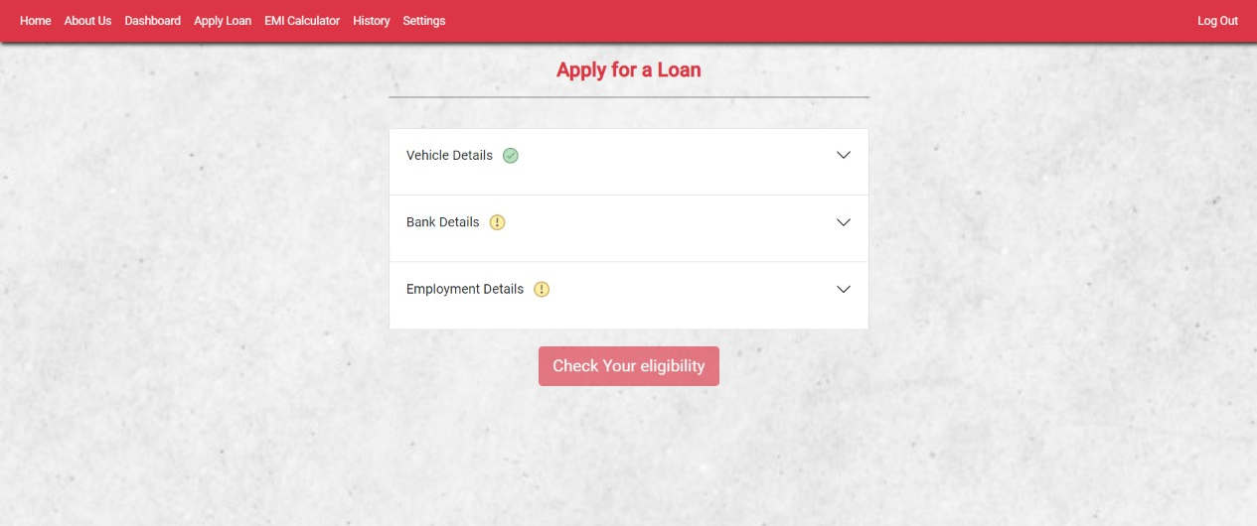
Screenshots
Apply loan

Slide 9
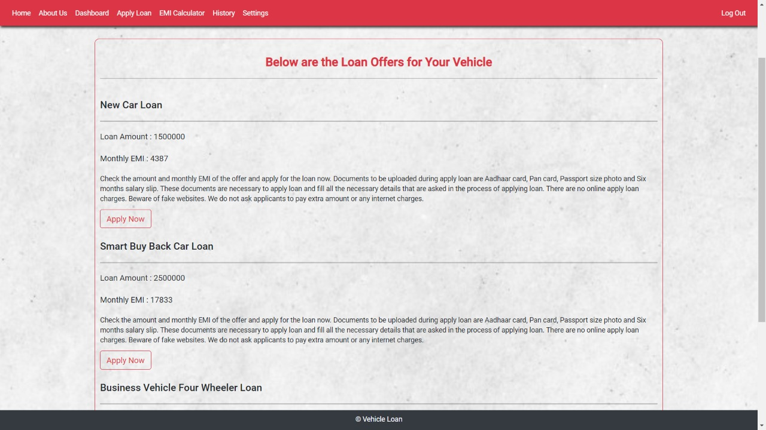
Screenshots
Loan offers

Slide 10
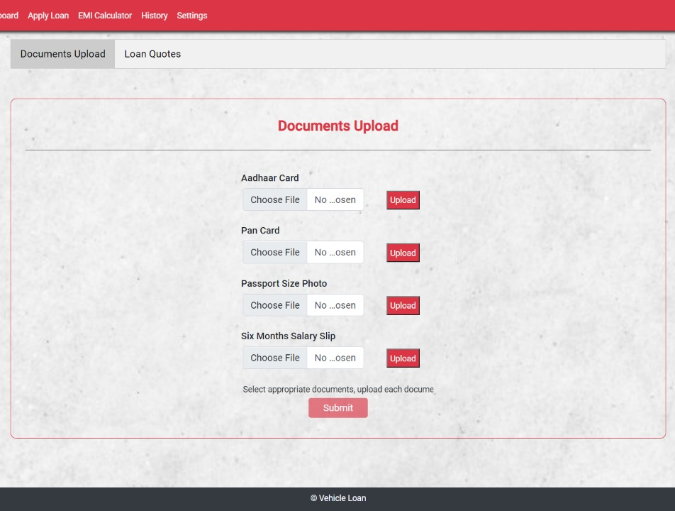
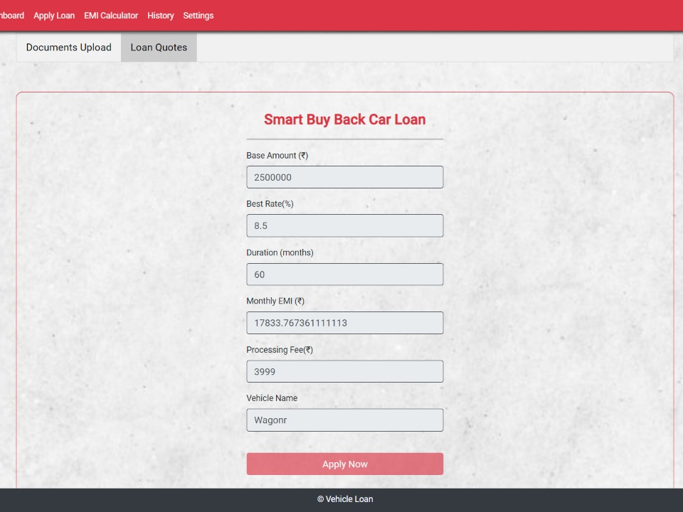
Screenshots
Loan Quotes & files upload

Slide 11
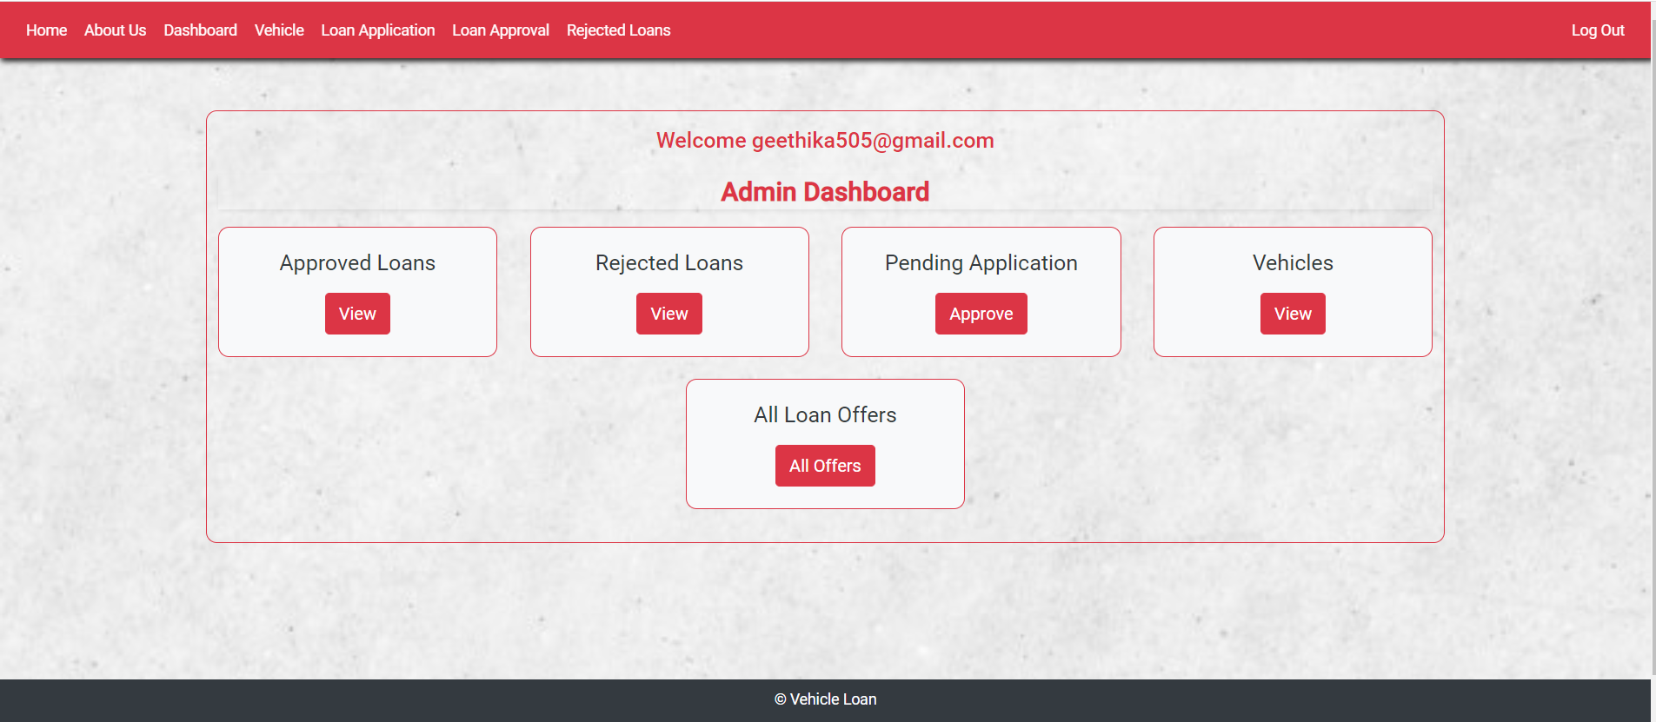
Screenshots
Admin Dashboard

Slide 12
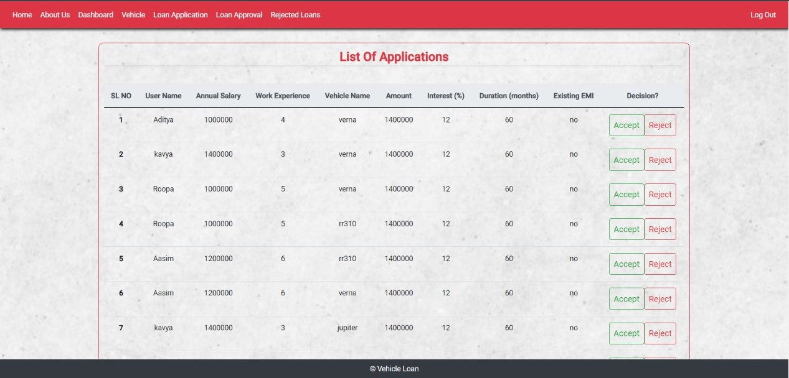
Screenshots
List of applications

Slide 13
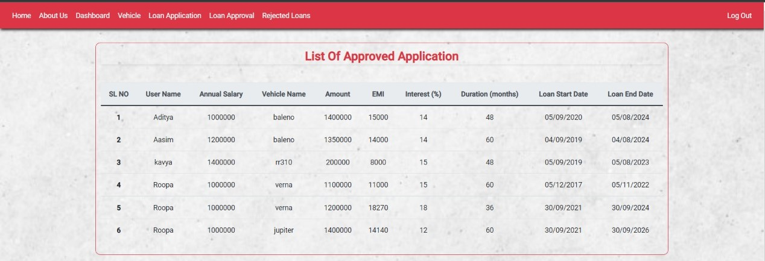
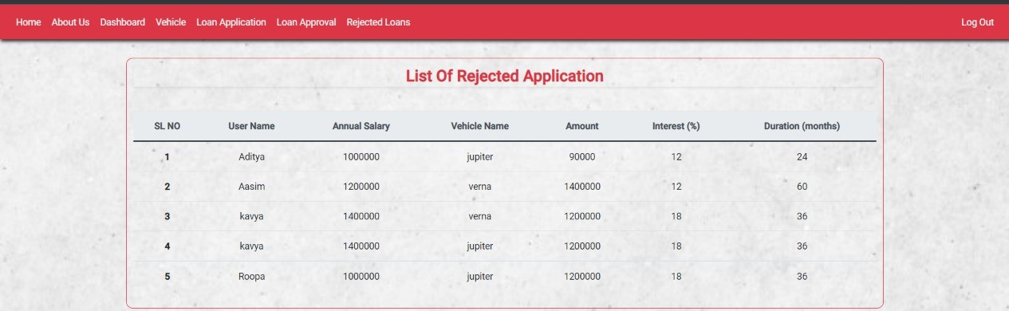
Screenshots
Approved list & rejected list

